Slide 1
Introduction to Michelman 麥可門公司介紹
千印企業有限公司
電話:02-26186020
傳真:02-26186014
蔡國男
most@ms18.hinet.net
www.mostin.com.tw

Slide 2
Our Locations 麥可門遍布全球

Slide 4
Michelman Solutions for HP Indigo 適用於HP Indigo的麥可門解决方案
Off-Line on demand 離線塗佈
In-Line with the Indigo Press 連線塗佈
At substrate converters 材料中間商
At HP approved treatment centres HP授權介質處理中心
At substrate manufacturers 材料生產商

Slide 5
Advantages of Michelman Solution 麥可門解决方案的優勢
Enhance the ink adhesion 增强油墨附附著力
Improve the service life of consumables 提高易耗品的使用壽命
Increase more printable materials and substrates 增加更多可印刷的材料
Reduce the pollution of the equipment 減少設備污染
Improve the color saturation and performance 提高色彩飽和度和表現力
Reduce the total cost of digital printing(ink consumption, materials) 降低數字印刷的總成本（墨量、材料）
Help customer to add more business opportunities 幫助客户增加更多的商機
The better combination of digital printing and traditional 數字印刷與傳统印刷的更好結合
……

Slide 6
Before we start … keep in mind … 在我們開始之前，請記住……
You can probably manage our chemistries on any machine but the challenge is :
你可能可以在任何機器上管理我們的化學物質，但挑戰是:
Practical (theory vs practice)
實用性(理論與實踐)
Manageable
易管理性
Repeatable
可重復性
Notes:
Toutes les encres indigo collent au primaire mais faire adhérer le priamre … plus compliqué qu’il n’y parait

Slide 7
Why priming? 為什么做底塗？
Make the connection between substrate and HP Indigo Electroinks
在基材與HP indigo電子油墨之前建立連接
For HP Indigo Commercial and L&P, all surfaces MUST be primed
標籤和包裝應用，所有基材表面都需要底塗
Defining substrate surface is first step: substrate surface must accept
WB primer –定義基材表面是第一步：基材表面必須能接受水性底塗
Specify: « Printable surface must accept aqueous coatings »
說明:«可印刷表面必須接受水性塗料»

Slide 8
Defining Substrate Surface 定義基材表面
This is the Key 這是關鍵
Paper (Uncoated, Coated, Metalized, Laminated, High Wet Strength)?
紙張(非塗布，塗佈，金屬，復合，濕度高)?
Film (Corona Treated, Uncoated, Top Coated, Chemically Treated)?
薄膜(電暈處理，無塗層，表面塗，化學處理)?
Surface Energy? 表面能？
Surface Functionality? 表面功能?
Always keep in mind final application 始終牢記最終的應用

Slide 9
Our « Super-Heroes » 明星產品
DP4431
DP5000
DP2000
Metalized Paper*
Rigid Vinyl
Coated Paper
PET
Uncoated Paper
OPS
Polyamide
Flexible Vinyl (PVC)
Other synthetics and most topcoats
Aluminum Foil
9

Slide 10
And their friends… 其他產品

Slide 11
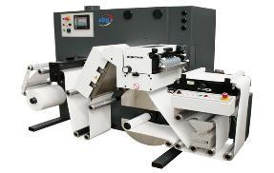
Off-Line Priming (in-house) 離線塗佈
Off-Line priming equipment options 離線塗佈機
Spare equipment, eg. Flexo unit
Bespoke primer coaters, eg. ABG DigiCon, C&J, Digicoat
Approved Michelman primers (wide range of grades)
Coater can be used for multiple presses 塗佈機可用於多台印刷機
Press operates independent of coater 印刷機獨立於塗佈機運行

Slide 12
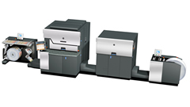
In-Line Priming (ILP)
Completely integrated with the Press 與印刷機融為一體
Approved Michelman ILP primers include 已認證產品
ILP030, DP680, DP050, DP060, Q4324A, Q4325A, EKF1636
Both Press and Priming unit can be run by one operator 印刷機與塗佈機可一人 操作
High flexibility 高靈活性
Broad range of substrates 廣泛的基材
12

Slide 13
3 key points when priming 底塗的3個要點
塗佈設備(the type of coating machine using)；
基材(substrates)；
電暈處理情况(corona dyne level)，合成印材需做電暈處理Corona treatment on synthetic substrates
塗佈工藝，塗佈輥類型(coating roller type)
塗佈克重(coat weight)
烘乾工藝(drying)；
印刷方式，油墨(printing)
測試求(tape test)
防粘情况(blocking for rewind or sheet stacking)
特殊工藝與要求(Special process and requirements)
13

Slide 14
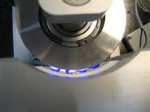
Make it work …
Substrate surface
Corona treat every film whether you need it or not – could solve
many issues電暈處理 ---解决諸多問題的關鍵
Use dyne pens to check the treatment level before you prime it – you want 42 or higher as a rule 底塗前用達恩筆測達因值，規定42以上
non-wetting – without corona
wetting – with corona
14

Slide 15
How to put down the right amount 如何進行適中塗佈
Use the right equipment
選用正確設備
ABG DigiCoat or any comparable flexo Coater with corona, decent drying, and good tension controls. 採用ABG DigiCoat 330 或任何有電暈，適度乾燥及張力控制的凹凸印刷機
Match the coat weight to the substrate
根據印材來决定塗佈量的大小
Use more for paper, especially uncoated papers纸材塗佈量大
Use more for textured surfaces 紋理面的基材多塗一些。
15

Slide 16
Drying 烘乾
A web temperature of 60 °C is recommended during drying to obtain full adhesion of the coating to the substrate. Be sure to cool the web down to less than 40 °C before winding or blocking in the wound roll occurs.
推薦印材温度60℃以獲得底塗同基材的完全粘合。確保收卷之前冷却到40℃以下的温度，否則容易出現發粘。
Depending on the substrate, the primer and the coating unit, these parameters may vary.
根據基材，底塗及塗佈設備的不同，這些参數也不盡相同。
16

Slide 17
Beverage飲料
Substrate type & surface
Primer Challenge底塗的挑戰
Ink Transfer & Adhesion油墨轉移與粘附
Consumables Lifespans消耗品壽命
Non Yellowing不會黃變
Varnish Challenge光油的挑戰
Adhesion to Ink對油墨的粘附
First Choice ILP030
Second Choice DP680
DP050 om HP20 000
Water Resistance防水
Bottle to Bottle test瓶對瓶試驗
Alcohol Resistance耐酒精
17

Slide 18
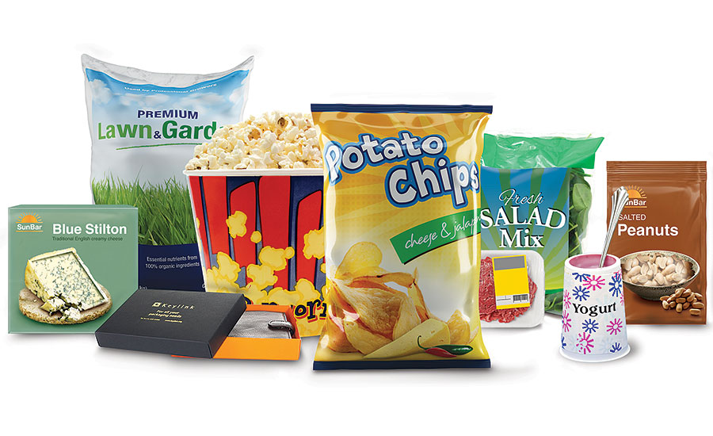
Flexible Packaging 軟包裝
Primer Challenge底塗的挑戰
Substrate Type & Surface
Define: Top surface printed or laminate? 定義:面屬印刷還是復合?
Ink Transfer & Adhesion油墨轉移與粘附
Consumables Lifespans消耗品壽命
Top Surface first choice ILP030
Reverse Print, sub-surface First choice DP680
DP050 on HP20 000
Varnish Challenge光油的挑戰
Adhesion to Ink油墨的粘附力
Food safe, Low odour, Low migration, Heat & Scuff Resistance食品安全，低氣味，低轉移，耐熱，耐磨損
Lamination Challenge復合的挑戰
Lamination Bond Strength復合强度
● HP Pack Ready Coating and Lamination Solution HP的塗層和層壓解决方案
● Michelman Mono-Structure Heat Seal Solutio 麥可門單層結構熱封解决方案
18

Slide 19
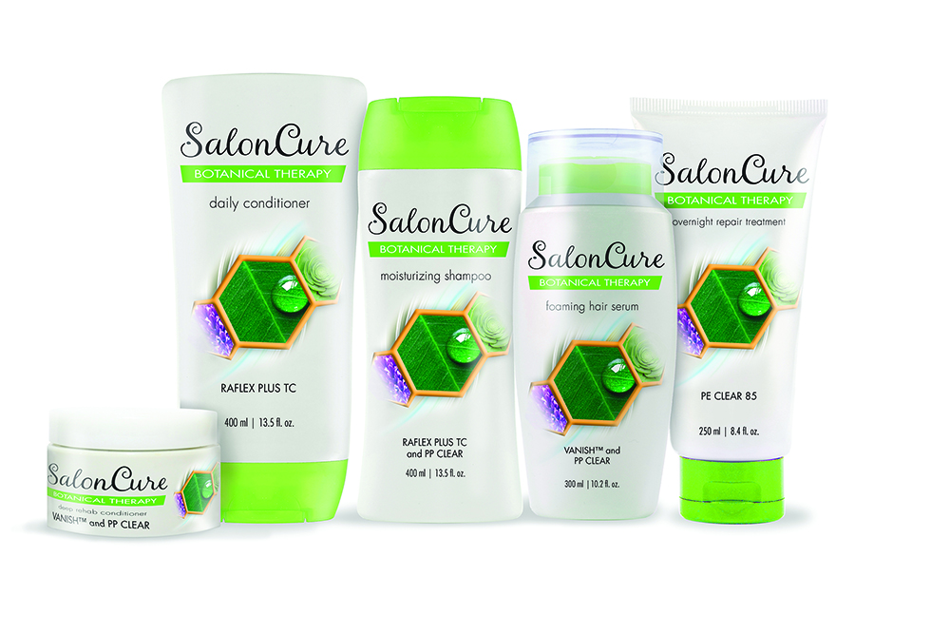
Personal Care個人護理用品
Primer Challenge底塗的挑戰
Substrate type & surface
Ink Transfer & Adhesion油墨轉移與粘附
Consumables Lifespans消耗品壽命
Water Resistance耐水性
First Choice ILP030
Second Choice DP680 - however lower water resistance
DP050 on HP20 000
Varnish Challenge光油的挑戰
Adhesion to Ink油墨的粘附力
Water Resistance耐水性
Product Resistance對自身產品的耐化學性
Scuff & Scratch Resistance耐磨損、耐割傷
19

Slide 20
Thank you! 謝謝！
蔡國男
0932188302
most@ms18.hinet.net

